Slide 1

ANEUVAS TECH. INC.
PORTABLE MEDICAL BENCH
Kenyon Rowley | Project Manager and Financial Manager
Katherine Riffle | Test Engineer and CAD Engineer
Hunter Daniel | Logistics Manager and Manufacturing Engineer
DR. BECKER - ADVISOR and CLIENT

Slide 2
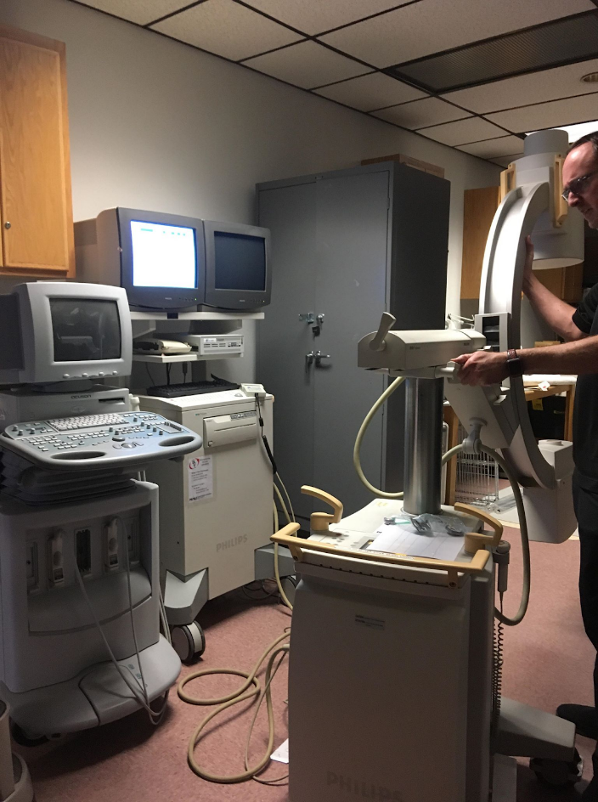
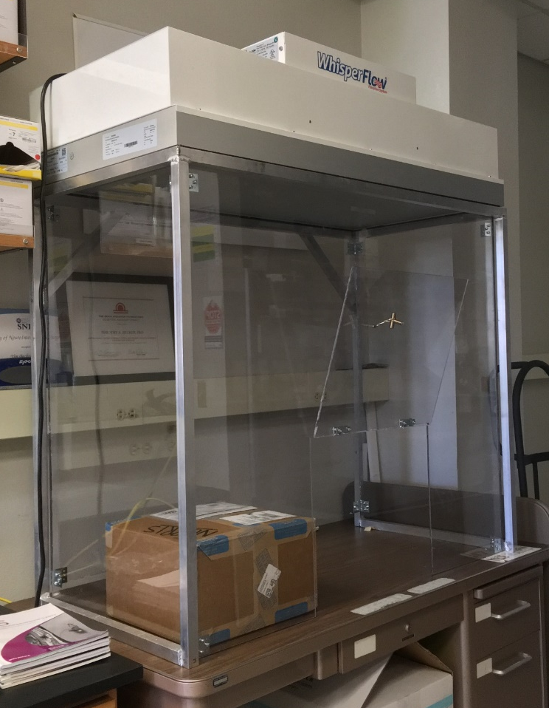
Project Description
Safely and easily transporting blood flow model experimental setup through buildings
Compatible and Protective of Medical Research Devices
Support Clean-Room Hood
Reduce Shock During Transport
X-Ray Machine Compatible
Spill Prevention
Fig 1: X-Ray Machine
Fig 2: Clean Room Hood and Air Filter
Kenyon Rowley, April 23, 19F05 - Aneuvas Tech Portable Bench
2

Slide 3
Specifications
Table 1: Engineering Requirements
Engineering Requirement | Units | Target Value | Tolerance | Met?
Cost | $ | 1000 | +/- 100 | Approved
Weight | lb | 150 | +/- 10 | Test
Fitting Through Doorway | ft² | 7.5 | +/- .1 | Test
Tabletop Yield Strength | psi | 5 | +/- 1 | Test
Effective shock absorption | in/s² | 5 | +/- 5 | Approved
Tabletop Deflection | in | 0.25 | +/- .05 | Test
Tabletop Thickness | in | 1.00 | +/- 0.10 | Met
Bench Height | in | 36.00 | +/- 0.10 | Met
Storage Volume | ft³ | 5 | +/- 1 | Met
Temperature resistance | °F | 50 | +/- 50 | Test
Liquid Drained | % | 80 | +/- 10 | Test
Kenyon Rowley, April 23, 19F05 - Aneuvas Tech Portable Bench

Slide 4
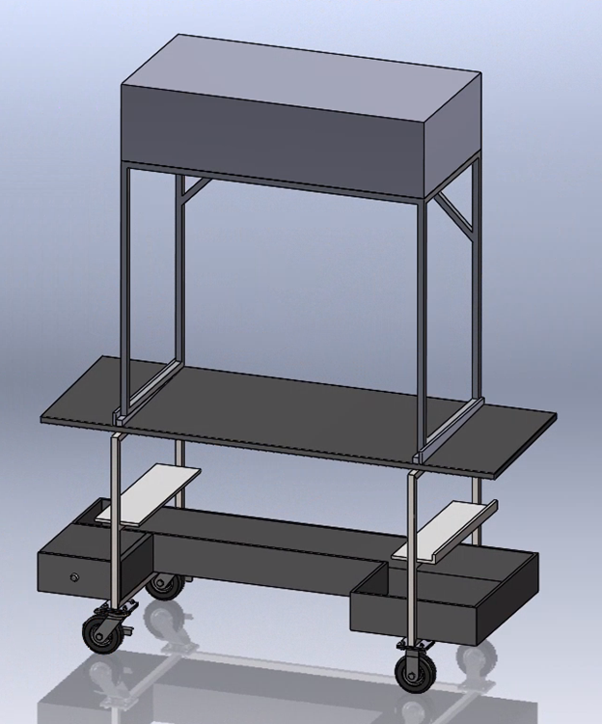
Design Solution
Table Top material selected was spill resistant and x-ray compatible
Table top, frame, and storage underwent multiple versions to ensure the safe and efficient transportation of equipment
Figure 3: Final CAD
Kenyon Rowley, April 23, 19F05 - Aneuvas Tech Portable Bench

Slide 5
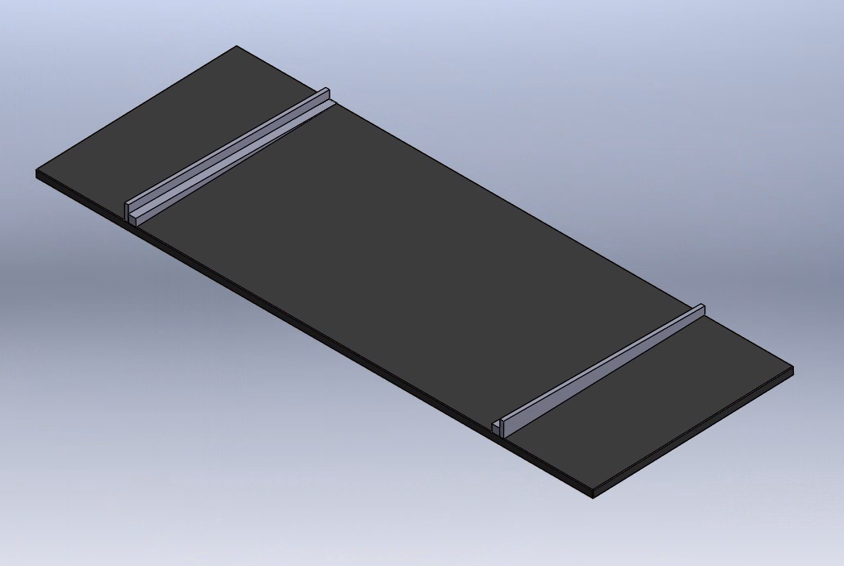
Design Description: Tabletop
Spill Guards attached around hood perimeter
No grooves for hood
Wilsonart - no polycarbonate workspace
No taper, only frame angled
Wedge attachments for frame
Figure 4: Tabletop with Wedges CAD
Kenyon Rowley, April 23, 19F05 - Aneuvas Tech Portable Bench

Slide 6
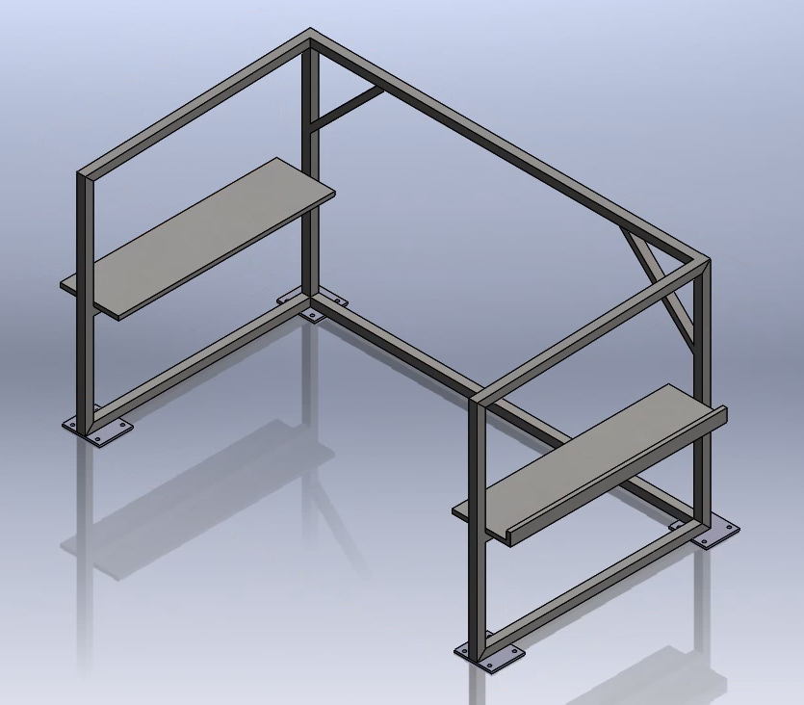
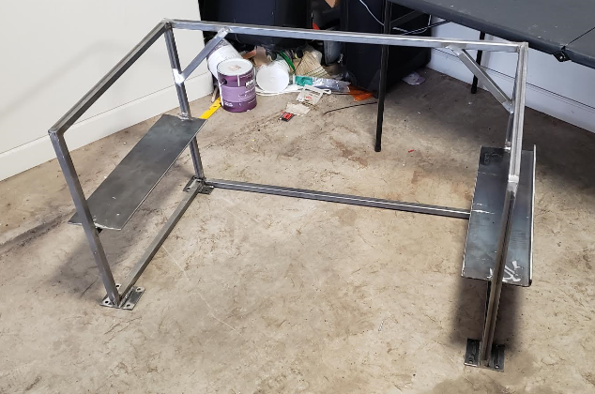
Design Description: Frame
Figure 5: Frame CAD and Constructed
Bolt Plates for Wheel Attachment, 1” Tilt from back to front
Air Filter Support Shelf for Transport
Katherine Riffle, April 23, 19F05 - Aneuvas Tech Portable Bench

Slide 7
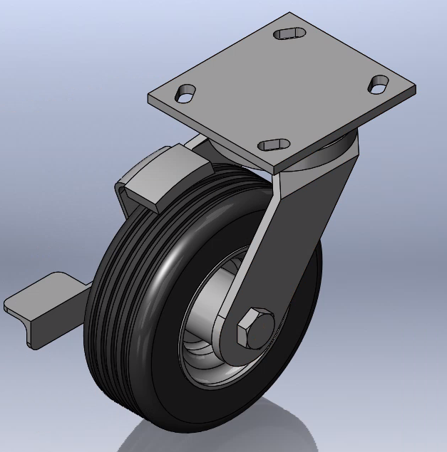
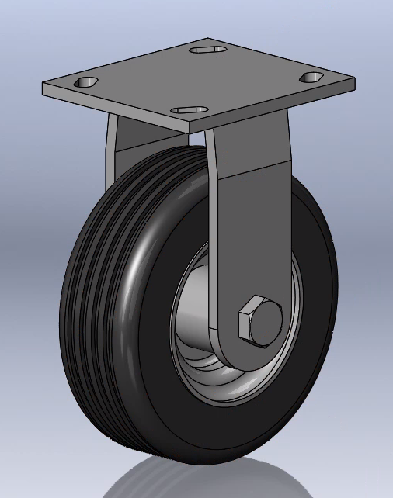
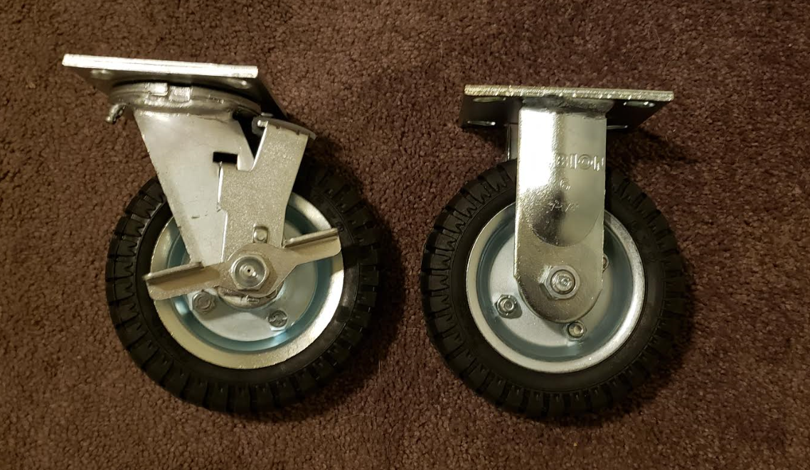
Design Description: Wheels
Selected for weight capacity and shock absorption
Bolted onto frame
Fig 6: Wheels, CAD and ordered
Katherine Riffle, April 23, 19F05 - Aneuvas Tech Portable Bench

Slide 8
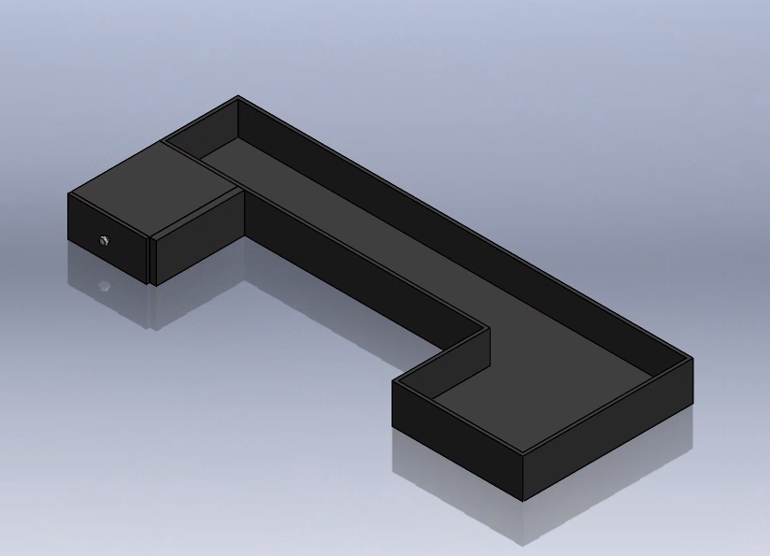
Design Description: Storage
Stores the 40lbs of devices
Two of three devices stored underneath: Reservoir, Super pump, and controller
Drawer to hold pens, pencils, etc. for multipurpose use
Fig 7: Storage CAD
Katherine Riffle, April 23, 19F05 - Aneuvas Tech Portable Bench

Slide 9
Decision Processes
Tabletop:
Oak and Polycarbonate → Wilsonart
Tilted Table Top → Angled Frame, Wedges
Spill Guards around Perimeter of Hood
Gutter Tray
Frame:
Dimensions Match Hood → Wider
Storage for Air Filter during transport
Storage:
Storage will be removable
Drawer slides have been omitted
Fig 8: Current SolidWorks Design
Katherine Riffle, April 23, 19F05 - Aneuvas Tech Portable Bench

Slide 10
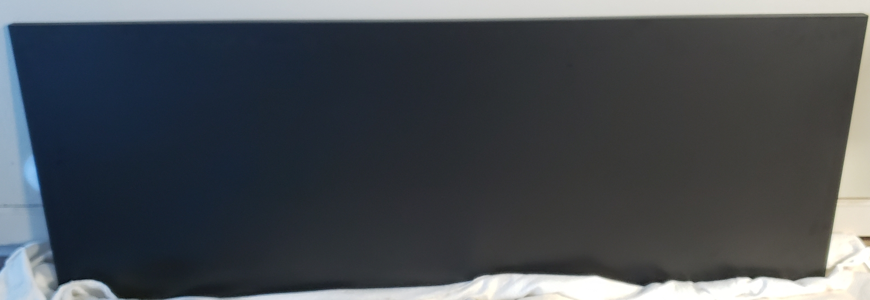
Manufacturing
Completed with a mixture of in-house and outsourced resources
Table top: Only Table Tops
Wheels: McMaster-Carr
Storage: In-house
Frame: Materials ordered, welding done in-house
Fig 9: Completed table top
Katherine Riffle, April 23, 19F05 - Aneuvas Tech Portable Bench

Slide 11
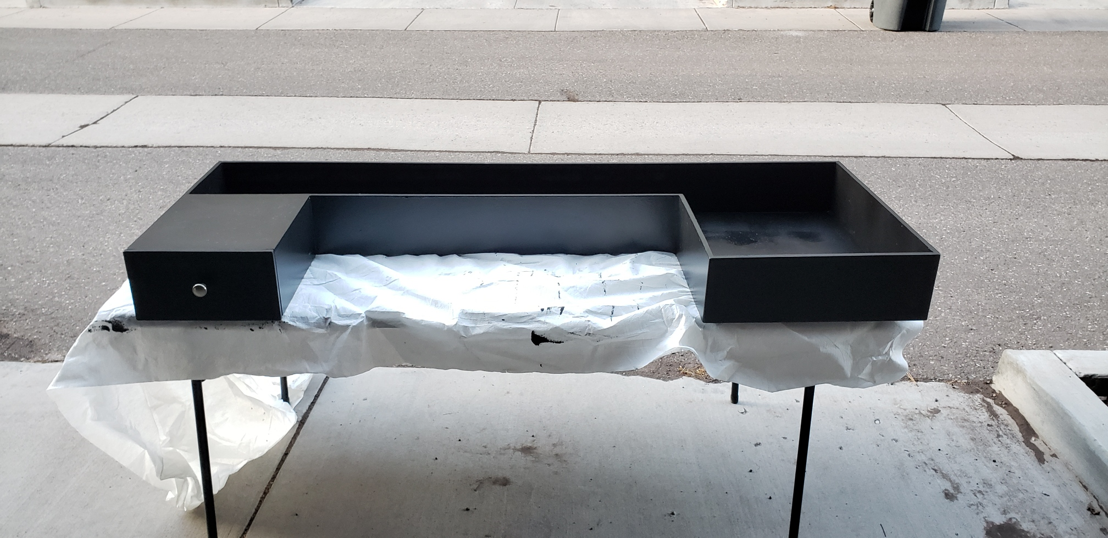
Testing
Team was unable to complete desired testing
The team was planning on completing testing in the Wettaw
These tests would have inspired design improvements
Figure 10: Completed storage
Hunter Daniel, April 23, 19F05 - Aneuvas Tech Portable Bench

Slide 12
Testing Procedures
Table 2: Testing Procedures 1-3
TP |  | ER |  | Requirements/Procedure
1 | Project Cost | 1 | Cost Target | Bill of Materials Approval from Dr. Becker and Dr. Oman
2 | Bench Specifications | 7 | Tabletop Thickness | Measure the Tabletop Thickness and Bench Height
 |  | 8 | Bench Height
 |  | 9 | Storage Volume | Fit devices in the storage area with client supervision
3 | Transporting Bench | 3 | Fitting Through Doorway | Bring the tabletop through the Wettaw building with client escort
 |  | 5 | Shock Absorption
Hunter Daniel, April 23, 19F05 - Aneuvas Tech Portable Bench

Slide 13
Testing Procedures
Table 3: Testing Procedures 4-7
TP |  | ER |  | Requirements/Procedure
4 | Temperature Resistance | 10 | Temperature Resistance | Hot Plate and Generator; Cold Flagstaff Day Clean Room Hood and Air Filter for Deflection and Yield Strength Measurements during extreme temperatures
5 | Liquid Drainage/ Deterioration | 11 | Liquid Drained | Measure amount of maximum spilled liquid retained and ensure tabletop does not deteriorate from lab fluids
6 | Weight | 2 | Overall Weight | Industrial scale; client’s approval of weight
7 | Tabletop Strength | 4 | Tabletop Yield Strength | Cleanroom Hood and Air Filter placed on top
 |  | 6 | Tabletop Deflection
Hunter Daniel, April 23, 19F05 - Aneuvas Tech Portable Bench

Slide 14
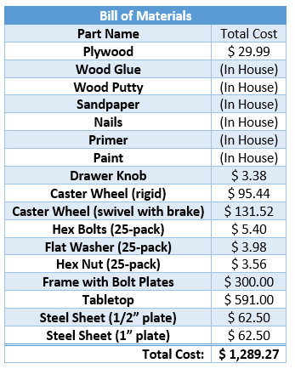
Budget
Hunter Daniel, April 23, 19F05 - Aneuvas Tech Portable Bench

Slide 15
Future Work
Completing the testing procedures
Evaluate how the bench completes tests
After procedures, make design changes to meet customer requirements
Hunter Daniel, April 23, 19F05 - Aneuvas Tech Portable Bench

Slide 16
ANEUVAS TECH. INC.
PORTABLE MEDICAL BENCH
Kenyon Rowley | kjr293@nau.edu
Katherine Riffle | krr264@nau.edu
Hunter Daniel | hbd6@nau.edu
DR. BECKER - ADVISOR and CLIENT

Slide 17
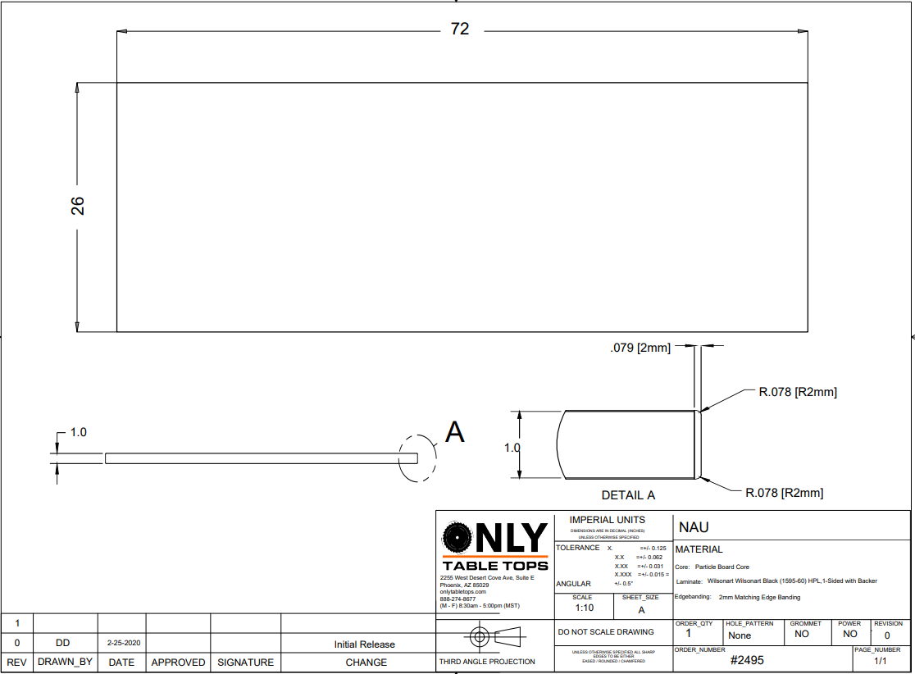
Appendix A: CAD Drawings

Slide 18
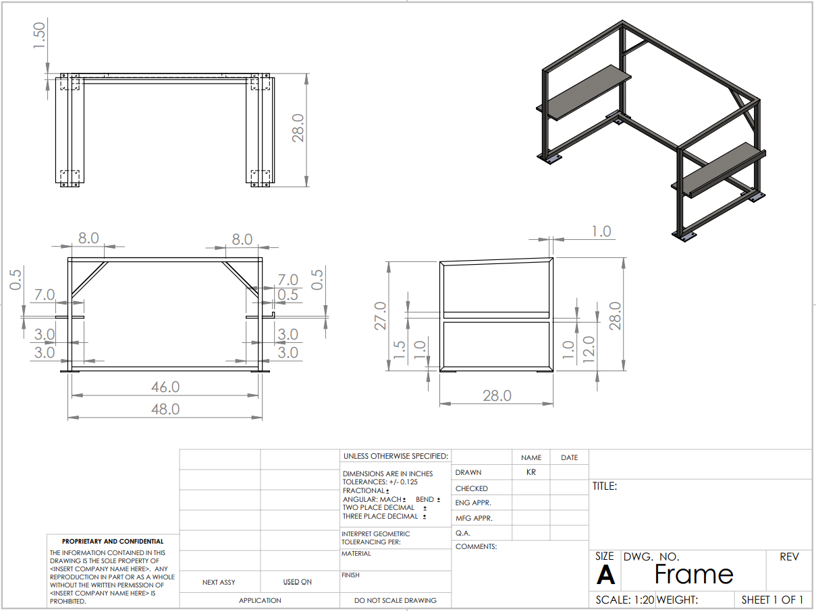
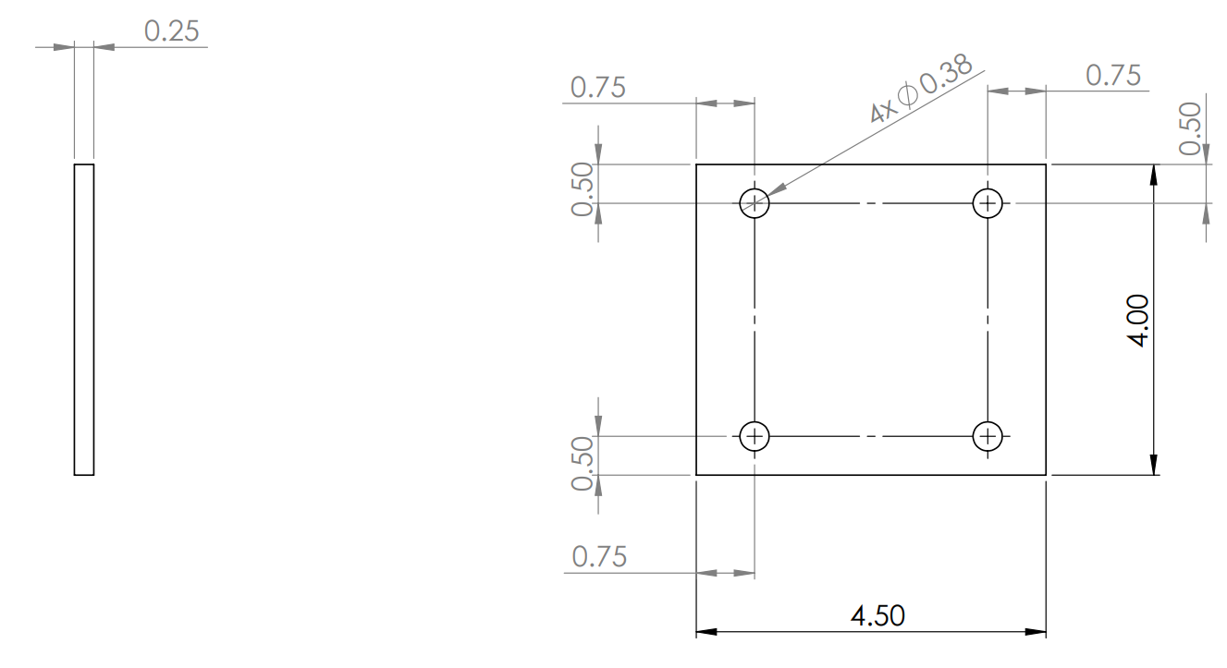
Appendix A: CAD Drawings

Slide 19
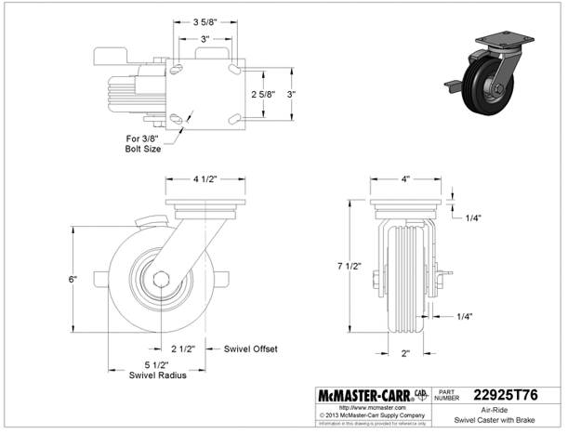
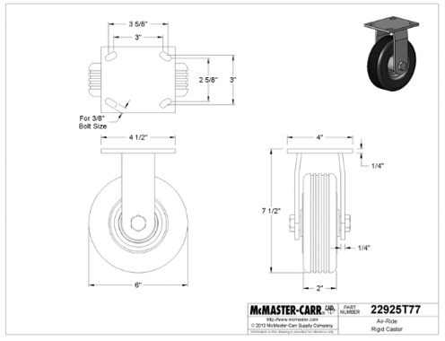
Appendix A: CAD Drawings

Slide 20
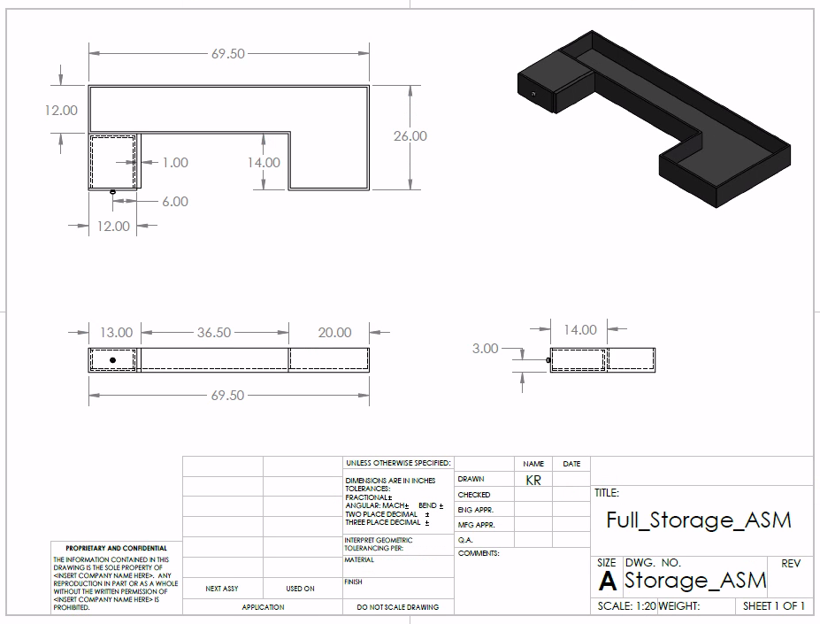
Appendix A: CAD Drawings

Slide 21
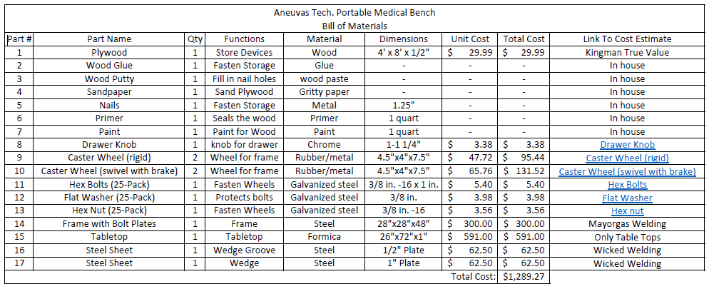
Appendix B: Full Bill of Materials

